Slide 1
Distributed Systems
Edited/Reviewed By: Dr. Anas Youssef
Email: anas.youssef@ci.menofia.edu.eg

Slide 2
Course Title: Software Engineering for Distributed Systems Course
Unit 3
Interprocess Communication
Material from
Distributed Systems: Concepts and Design, 5th edition. Coulouris, et. Al

Slide 3
Introduction
Distributed systems need support from programming languages for distribution. Support is needed to perform operations such as remote procedure calls or remote method invocations.
Access transparency: the remote version should be as close to the local version as possible.
Middleware such as CORBA, Java RMI, and WS makes it possible to build distributed systems using different programming languages or run on different hardware platforms.

Slide 4
Objectives
Upon completion of this unit, students will have good understanding of:
The general characteristics of interprocess communication
The logical relationship between distributed systems components

Slide 5
Unit 3: List of topics
Topic # | Topic
Topic 1 | Processes
Topic 2 | Transaction oriented communication
Topic 3 | Message oriented communication
Topic 4 | Remote invocation

Slide 6
Topic 1 Processes
Material From:
Chapter 3 of Tanenbaum and van Steen, Distributed Systems, Principles and Paradigms
Douglas E. Comer and David L. Stevens, Internetworking With TCP/IP, Volume III, Prentice Hall, multiple editions and dates.
http://web.njit.edu/~gblank/

Slide 7
Topic1: Processes
A process is a program in execution.
Modern systems have many processes running at the same time. Most applications require more than one process to be running. Large systems can have thousands.
Each process takes time to load and unload, and consumes resources like CPU time, memory, file handles, and disk access.
Functioning and organization of processes is a major topic in distributed computing.

Slide 8
Process Overhead
One major concern in corporate computing is throughput or efficiency.
Large volumes of data will require more staff, more real estate, and more equipment on slower systems. For most large companies, the differences in efficiency can amount to many millions of dollars.
One major concern in performance is process overhead, particularly starting up and shutting down processes and allocating resources to them.

Slide 9
Shared Processes
One approach to efficiency is to keep a number of processes open all the time to share among multiple users, to avoid start-up, shut-down and other overhead activities.
Transaction processing monitors are software applications specialized for this.
They can also increase the number of processes to run small ones that demand few resources and reduce the number for large processes needing many resources.

Slide 10
Threads
Threads can be used to maximize throughput. A single process can be multi-threaded, so that several tasks can occur in parallel.
A single threaded process may block for an activity such as disk access, which may cause the process to miss an event such as a mouse click.
Threads are similar to processes, also using time slices, but require less information, less data swapping, and less protection from interference because they are shared by a single process which tracks the common requirements.

Slide 11
Advantages
A multithreaded application can handle parallel tasks. For example, a word processor can use one thread for editing, another for spell checking, one to generate an index and another to display the text layout on the screen.
Frequently, switching threads requires only loading the CPU registers instead of the whole process context.
Threads can also increase throughput in multiprocessor systems.

Slide 12
Thread Safety
The biggest disadvantage of threads is that because they have less protection from interference than processes, they require careful design and intelligent programming.
The programmer must understand the pitfalls so they can be avoided.
Programming practices for multithreading refer to this concern as thread safety.

Slide 13
Threads in Distributed Systems
The ability to make system calls without suspending all other processes is important in distributed systems, because it allows multiple logical connections at the same time.
Remote communications have high latencies. Think of the several seconds you have waited before getting a 404 error on the Internet.
Computer functionality would be greatly reduced if the whole system had to wait for a network operation to complete, and only one could occur at a time.

Slide 14
Multithreaded Servers
The main benefit of multithreaded network communications is on the server side, because a single server may simultaneously serve many clients.
Frequently a concurrent server will start a new thread to handle each client, as shown in the next slide.

Slide 15
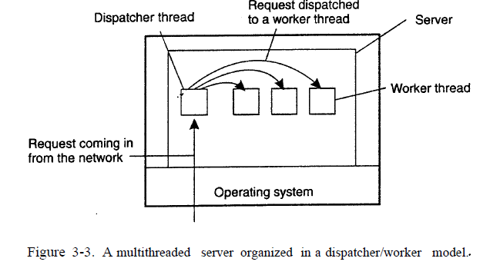
Multithreaded Servers Example

Slide 16
Code Migration
One of the most important considerations in commercial Information Technology is efficiency or throughput.
One way to get more processing for the same amount of money is to move processing from heavily loaded systems to lightly loaded systems. This is one aspect of code migration.

Slide 17
Fat Client and Fat Server
Code processing can take place anywhere on a system.
If most of the processing takes place on the server, it is called a Fat Server, while the opposite is a Fat Client.
Thus, if a server cannot handle all the load that is thrown at it, an alternative to buying another expensive server is to move some of the more intensive computation to the clients by migrating some of the code.
In addition to increasing performance, this can also increase flexibility.

Slide 18
Efficient Migration
If code can be moved easily between machines, then it is possible to dynamically configure distributed systems.
This is a key idea behind distributed object systems such as CORBA, where the application environment can be very dynamic, involving many objects, with new objects able to be added at any time and others moved to faster machines or ones with spare capacity.

Slide 19
Java Applet
Another example of code migration is the Java Applet, which can be fetched from a server and execute on a client.
The applet can also access the server for functionality that is not sent to the client.

Slide 20
Weak Mobility
A bare minimum for code migration is the ability to transfer only the code segment and some initialization data.
The code segment is the part that contains the set of instructions that make up the program that is being executed.
This is called weak mobility.
This is simple to accomplish, and only requires that the code be portable so that the client can execute it.

Slide 21
Strong Mobility
If you also download the execution segment, then you have strong mobility.
The execution segment is used to store the current execution state of a process, consisting of private data, the stack, and, of course, the program counter.
A key distinction is that with strong mobility a running process can be stopped, moved to another machine, and resume where it left off.
Strong mobility is more difficult to implement.

Slide 22
Mobility Initiation
Another distinction is whether the mobility is sender-initiated or receiver-initiated.
sender-initiated mobility: migration is initiated by the sender to the machine where the code is being executed
Sender initiation examples are uploading programs to a computer server, or initiating a search on a remote server.
Receiver initiated mobility is when the receiving machine requests the code, such as downloading a Java Applet.

Slide 23
Topic 2
Transaction oriented
Material From:
http://www.dcl.hpi.uni-potsdam.de/teaching/mds/
Chapter 8 of Tanenbaum and van Steen, Distributed Systems, Principles and Paradigms

Slide 24
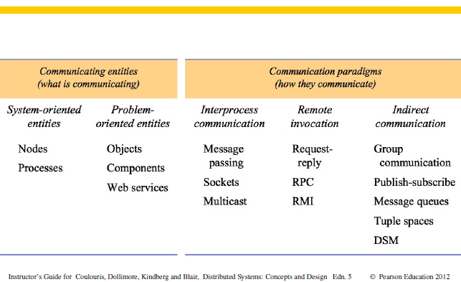
Communicating entities and paradigms

Slide 25
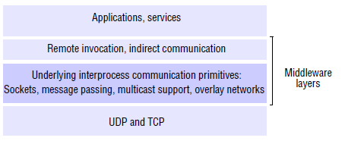
Communication Layers

Slide 26
Types of Middleware
Transaction-Oriented
Suited for Database Applications
IBM CICS, BEA Tuxedo, and Encina
Message-Oriented
Suited for Asynchronous (EDI,Batch)
IBM MQSeries, DEC Message Queue, NCR TopEnd, and (SOAP)
Remote invocation
RPC Systems
ANSA, Sun ONC, OSF/DCE, and (SOAP)
Object-Oriented
OMG/CORBA, DCOM, Java/RMI/EJB, .NET Remoting, and (SOAP)

Slide 27
Transaction-Oriented Middleware
Supports transactions across different distributed DB systems and ensures that an atomic operation either occurs completely or not at all.
Distributed transaction are implemented by the use of Two-phase commit protocol.
Don’t use Transactions, if transactions are not required for an operation to avoid unnecessary overhead.
Products: IBM CICS, BEA Tuxedo, etc.

Slide 28
Terminology
Financial Transaction (purchase, loan, mortgage, ...)
Database Transaction: unit of interaction between a process and a relational database
Atomic transaction: sequence of operations that should be atomic
not necessarily limited to databases - may involve regular ﬁles, or actions "in the real world"
all-or-nothing: either completely succeed or completely fail
failure atomicity: atomic even in the presence of crashes
durability: changes should persist once transaction succeeds
isolation: concurrent transactions must not interfere

Slide 29
ACID Properties of Transactions
Härder and Reuter, Principles of Transaction-Oriented Database Recovery, Computing Surveys, 1983
Atomicity: updates are all-or-nothing
Consistency: a transaction takes the system from one consistent state to another consistent state
Isolation: intermediate states are not observable to other transactions
Durability: changes are not undone after a transaction completes

Slide 30
Distributed Transactions
client invokes operations on different servers
effects should be atomic across all servers
ﬂat vs. nested
ﬂat: a client starts a transaction, then sequentially performs operations on multiple servers
nested: within a transaction, further transactions can be started; sub-transactions may run concurrently

Slide 31
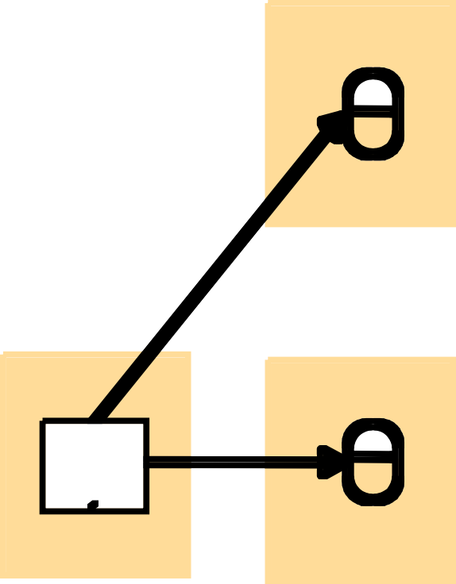
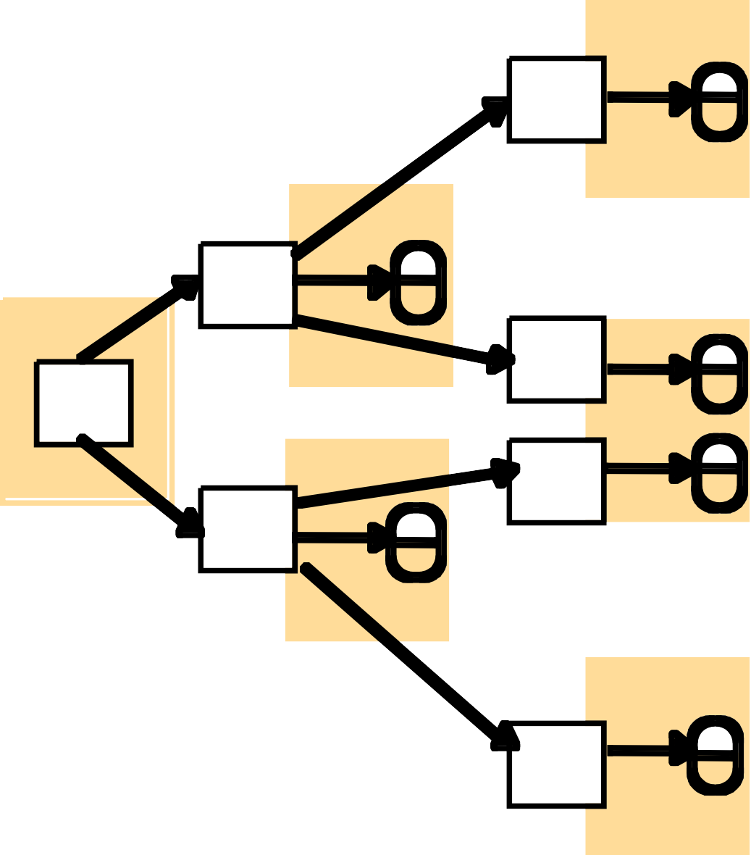

Distributed Transactions
© Pearson Education 2005
M
X
^{T}11
X
Client
T
1
N
T
^{T} 12
Y
T
T
T
T₂
21
Client
Y
Z
P
T
22

Slide 32
Transaction Coordinator
aka Transaction Manager or Transaction Monitor
allows identiﬁcation of transactions, and keeps track of participants (resources) of a transaction
openTransaction: start a new transaction, returns transaction handle
closeTransaction: complete transaction successfully
abortTransaction: discard all partial changes
join: include a reference to a participant (process) into the transaction
client needs to communicate transaction handle to all participants
coordinator does not talk to participants during the transaction (only at the end)

Slide 33
Transaction lifetime
A transaction is achieved by cooperation between a client program, some recoverable objects and a coordinator.
The client specifies the sequence of invocations on recoverable objects that are to comprise a transaction.
The client sends with each invocation the TID returned by openTransaction.
The client may include an extra argument in each operation of a recoverable object with the TID.
For example, in the banking service the deposit operation might be defined:
account.deposit(trans, amount)
Deposits amount in the account for transaction trans

Slide 34
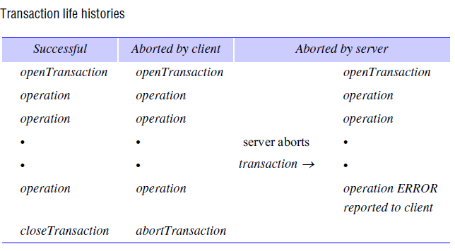
Transaction lifetime

Slide 35
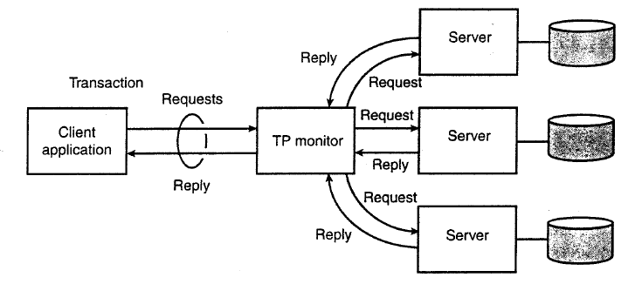
Transaction Coordinator

Slide 36




Transaction Coordinator
Coordinator
© Pearson Education 2005
openTransaction closeTransaction
join
participant
.
A
a.withdraw(4);
join
BranchX
T
participant
Client
b.withdraw(T, 3);
B
b.withdraw(3);
T = openTransaction a.withdraw(4);
c.deposit(4); b.withdraw(3); d.deposit(3); closeTransaction
BranchY
join
participant
C D
BranchZ
c.deposit(4);
d.deposit(3);
Note: the coordinator is in one of the servers, e.g. BranchX

Slide 37
Atomic Commit Protocols
One-Phase Commit
coordinator sends commit/abort messages to all participants
each participant individually commits local changes
problem: what if a server fails to commit, e.g. when the server had to break a lock to resolve a deadlock with some other transaction

Slide 38
Atomic Commit Protocols
Two-Phase Commit(2PC) (Gray 1978)
commit-request phase (voting or prepare phase): participants vote to commit or abort transactions
The coordinator sends a query to commit message to all participants and waits until it has received a reply from them
Each participant executes the transaction up to the point where they will be asked to commit. Each participant writes an entry to its prepare logs (undo log and redo log)
Each participant either votes Yes or No
participants who voted Yes, must not change their minds
commit phase: participants all commit

Slide 39
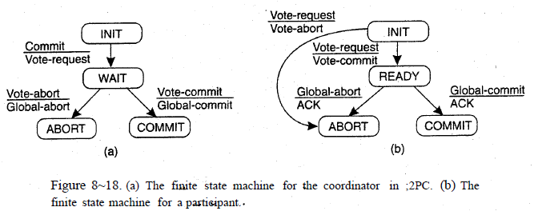
Atomic Commit Protocols
Two-Phase Commit(2PC) (Gray 1978)

Slide 40
Failures – participant crash or timeout
participant crash
participant gets restarted from a consistent state
information about ongoing transactions might have been lost, so prepare messages from coordinator result in aborts
in a crash after a "commit" vote, server needs to recover with prepare log
participant time-out
coordinator may abort transaction after participant timeout

Slide 41
Failures – coordinator crash
coordinator should maintain a log of ongoing transactions to be redone during recovery
for started transactions without completed prepare phase: abort
if no vote was recorded for some participant: ask again
if abort/commit was logged: redo abort/commit
participant needs to ﬁnd out global state, by asking restarted coordinator, if coordinator states that the crash occurs:
before prepare message is sent: participant can safely abort transaction
after prepare message is sent (uncertainty period): participant needs to wait for coordinator final decision , or try to ﬁnd other participants

Slide 42
Correctness of 2PC
Safety: if one process is in a ﬁnal (committed/aborted) state, then either all processes are in the committed state, or all processes are in the aborted state
Liveness: for a ﬁnite number of failures, 2PC will reach a ﬁnal global state after a ﬁnite sequence of state transitions (i.e. messages sent)

Slide 43
Nested Transactions
Additional operations on coordinator:
openSubTransaction(trans ID) : nested transaction ID must include/refer to parent transaction
Transaction status may be committed, aborted, or provisional
provisional commit is not durable, and visible only within the outer transaction
Participant may lose information about provisional commits in a crash
Parent transaction can be committed even if sub-transactions failed
Application needs to take appropriate corrective measures (e.g. retry)

Slide 44
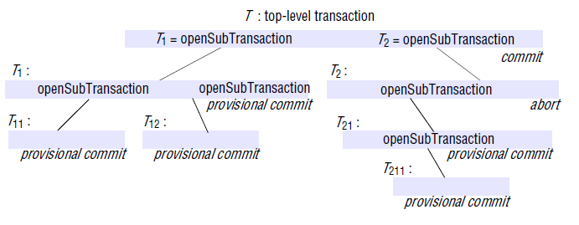
Nested Transactions (2)

Slide 45
Nested Transactions (3)
Each subtransaction can fail independently of its parent and of the other subtransactions.
When a subtransaction aborts, the parent transaction can sometimes choose an alternative subtransaction to complete its task.
e.g., a transaction to deliver a mail message to a list of recipients could be structured as a set of subtransactions, each of which delivers the message to one of the recipients.
If one or more of the subtransactions fails, the parent transaction could record the fact and then commit, with the result that all the successful child transactions commit.
Parent transaction could then start another transaction to attempt to redeliver the messages that were not sent.

Slide 46
Nested Transactions (4)
Rules for committing nested transactions:
A parent transaction may commit or abort only after its child transactions have completed.
When a subtransaction completes, it makes an independent decision either to commit provisionally or to abort. Its decision to abort is final.
When a parent aborts, all of its subtransactions are aborted. For example, if T₂ aborts then T₂₁ and T₂₁₁ must also abort, even though they may have provisionally committed.
When a subtransaction aborts, the parent can decide whether to abort or not, e.g., T decides to commit although T₂ has aborted.

Slide 47
Nested Transactions (5)
Rules for committing nested transactions:
If the top-level transaction commits, then all of the subtransactions that have provisionally committed can commit too, provided that none of their ancestors has aborted.
E.g., T’s commitment allows T₁, T₁₁ and T₁₂ to commit, but not T₂₁ and T₂₁₁ since their parent, T₂, aborted.
Generally the effects of a subtransaction are not permanent until the top-level transaction commits.

Slide 48
Thank you for
your attention.

